Slide 1
ETL and Data Pipelines-Tools and Techniques
C8-Week-2
Learning Objectives
Summarize what happens in each of the three stages of ETL: extraction, transformation, and loading.
Explain the importance of ETL data pipelines and how they work.
List popular ETL tools.
Summarize how to use shell scripting to implement an ETL pipeline.
Explain how to schedule ETL scripts/tasks
Perform ETL tasks using shell scripts.
Define what a data pipeline is.
Describe data pipeline performance in terms of latency and throughput.
List key data pipeline processes.
Describe data pipeline solutions for mitigating data flow bottlenecks.
Differentiate between batch processing and stream processing.
List use cases for batch and streaming data pipelines.
Discuss data pipeline technologies.
Identify streaming data pipeline tools.

Slide 2
Part 1: ETL using Shell Scripts

Slide 3
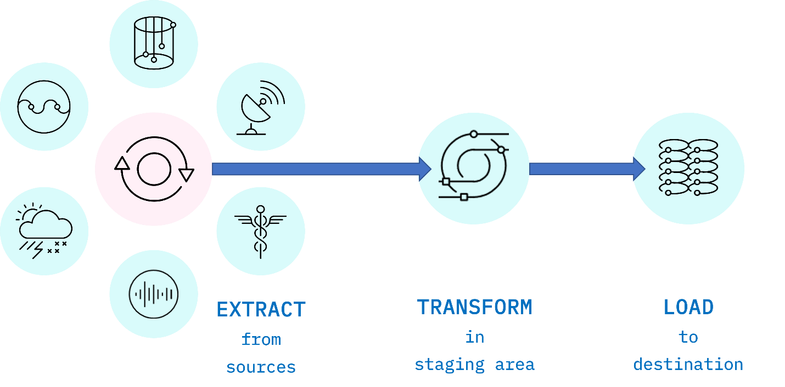
ETL Techniques
ETL stands for Extract, Transform, and Load, and refers to the process of curating data from multiple sources, conforming it to a unified data format or structure, and loading the transformed data into its new environment.
Fig. 1. ETL is an acronym used to describe the main processes behind a data pipeline design methodology that stands for Extract-Transform-Load. Data is extracted from disparate sources to an intermediate staging area where it is integrated and prepared for loading into a destination such as a data warehouse.

Slide 4
Extract
Data extraction is the first stage of the ETL process, where data is acquired from various source systems. The data may be completely raw, such as sensor data from IoT devices, or perhaps it is unstructured data from scanned medical documents or company emails. It may be streaming data coming from a social media network or near real-time stock market buy/sell transactions, or it may come from existing enterprise databases and data warehouses.
Transform
The transformation stage is where rules and processes are applied to the data to prepare it for loading into the target system. This is normally done in an intermediate working environment called a “staging area.” Here, the data are cleaned to ensure reliability and conformed to ensure compatibility with the target system.
Many other transformations may be applied, including:
Cleaning: fixing any errors or missing values
Filtering: selecting only what is needed
Joining: merging disparate data sources
Normalizing: converting data to common units
Data Structuring: converting one data format to another, such as JSON, XML, or CSV to database tables
Feature Engineering: creating KPIs for dashboards or machine learning
Anonymizing and Encrypting: ensuring privacy and security
Sorting: ordering the data to improve search performance
Aggregating: summarizing granular data

Slide 5
Load
The load phase is all about writing the transformed data to a target system. The system can be as simple as a comma-separated file, which is essentially just a table of data like an Excel spreadsheet. The target can also be a database, which may be part of a much more elaborate system, such as a data warehouse, a data mart, data lake, or some other unified, centralized data store forming the basis for analysis, modeling, and data-driven decision making by business analysts, managers, executives, data scientists, and users at all levels of the enterprise.
In most cases, as data is being loaded into a database, the constraints defined by its schema must be satisfied for the workflow to run successfully. The schema, a set of rules called integrity constraints, includes rules such as uniqueness, referential integrity, and mandatory fields. Thus such requirements imposed on the loading phase help ensure overall data quality.

Slide 6
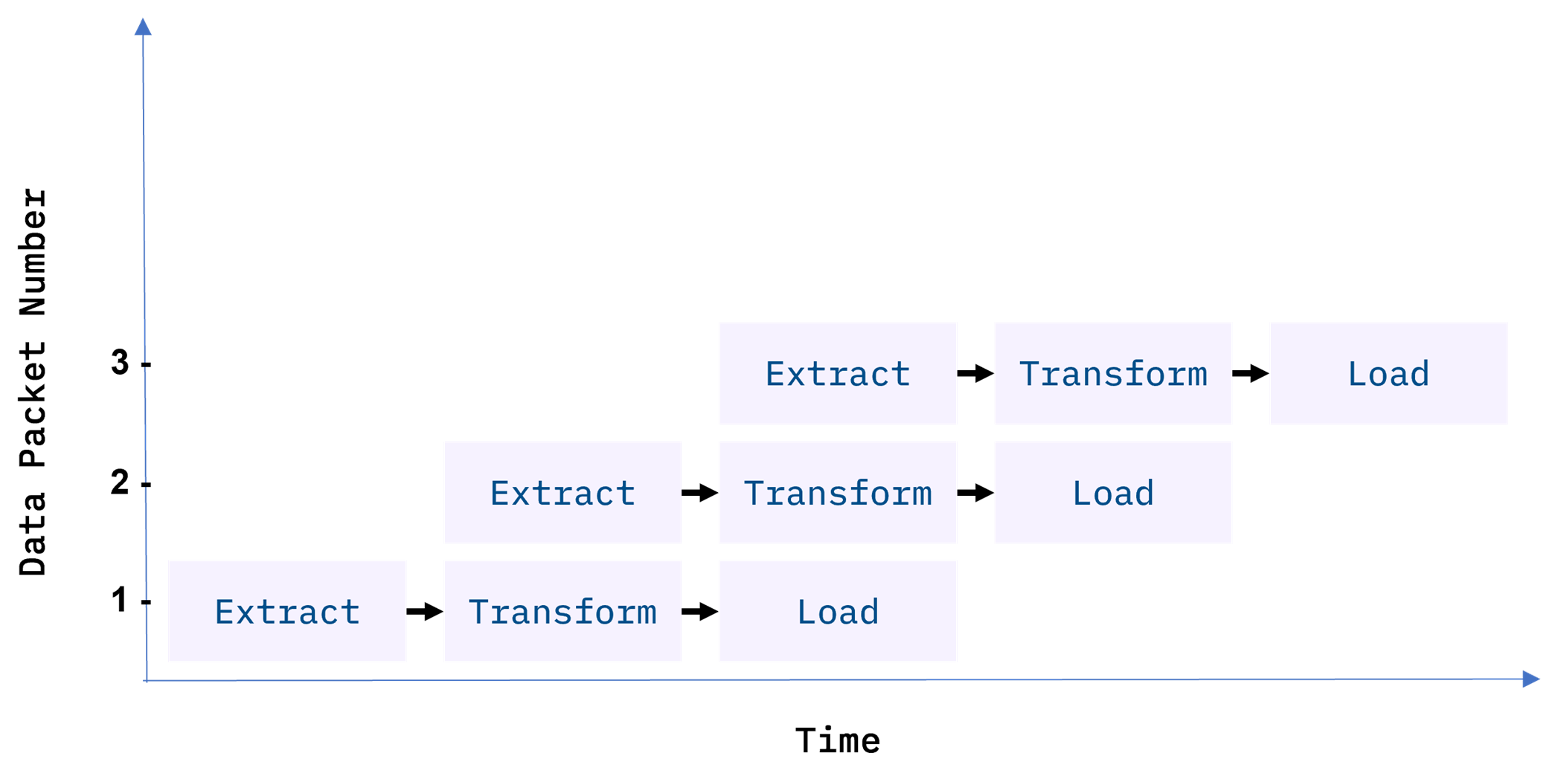
ETL Workflows as Data Pipelines
Generally, an ETL workflow is a well thought out process that is carefully engineered to meet technical and end-user requirements.
Traditionally, the overall accuracy of the ETL workflow has been a more important requirement than speed, although efficiency is usually an important factor in minimizing resource costs. To boost efficiency, data is fed through a data pipeline in smaller packets (see Figure 2). While one packet is being extracted, an earlier packet is being transformed, and another is being loaded. In this way, data can keep moving through the workflow without interruption. Any remaining bottlenecks within the pipeline can often be handled by parallelizing slower tasks.

Slide 7
Fig 2. Data packets being fed in sequence, or “piped” through the ETL data pipeline. Ideally, by the time the third packet is ingested, all three ETL processes are running simultaneously on different packets.
With conventional ETL pipelines, data is processed in batches, usually on a repeating schedule that ranges from hours to days apart. For example, records accumulating in an Online Transaction Processing System (OLTP) can be moved as a daily batch process to one or more Online Analytics Processing (OLAP) systems where subsequent analysis of large volumes of historical data is carried out.
Batch processing intervals need not be periodic and can be triggered by events, such as
when the source data reaches a certain size, or
when an event of interest occurs and is detected by a system, such as an intruder alert, or
on-demand, with web apps such as music or video streaming services

Slide 9
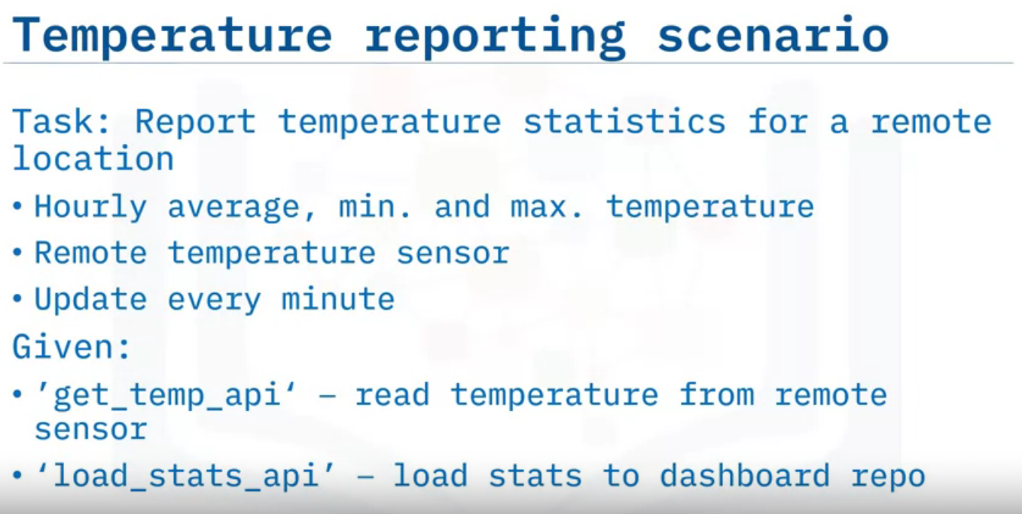
ETL using Shell Scripting
Given Scenario

Slide 10
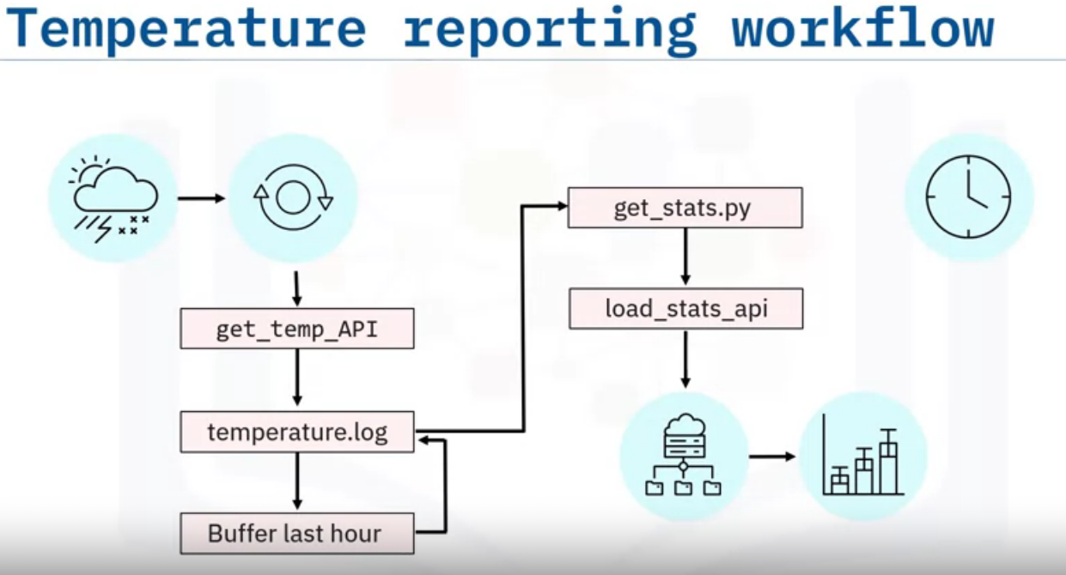
Let's sketch the workflow for your ETL pipeline, starting with the weather station and its data interface.
The extraction step involves obtaining a current temperature reading from the sensor using the supplied ‘get_temp’ API.
You can append the reading to a log file, say ‘temperature.log’. Since you will only need to keep the most recent hour of readings, buffer the last 60 readings, and then just overwrite the log file with the buffered readings.
Next, call a program, for example, a python script called ‘get_stats.py’, which calculates the temperature stats from the 60-minute log, and loads the resulting stats into the reporting system using the load_stats API.
The stats can then be used to display a live chart showing the hourly min, max and average temperatures.
You will also want to schedule your workflow to run every minute

Slide 11
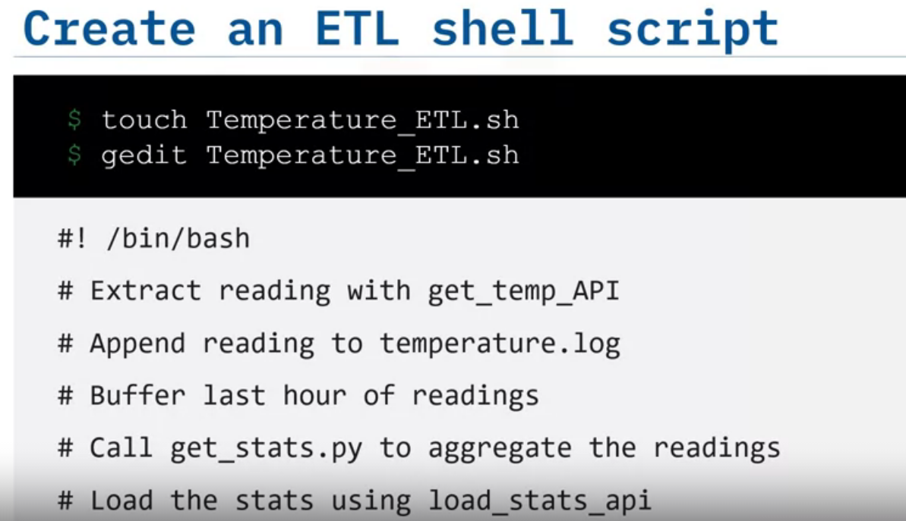
start by creating a shell script called ‘Temperature_ETL.sh’.
You can create the file by using the touch command.
Next, open the file with any text editor, such as ‘gedit’.
In the editor, type in the Bash shebang to turn your file into a Bash shell script.
Now you can add the following comments to help outline your tasks:
Extract a temperature reading from the sensor using the supplied ‘get_temp’ API,
Append the reading to a log file, say ‘temperature.log’.
You only need to keep the most recent hour of readings, so buffer the last 60 readings.
Call a program, say a python script called ‘get_stats.py’, which calculates the temperature stats from the 60-minute log, and load the resulting stats into the reporting system using the supplied API.
After you finish writing the ETL bash script, you will need to schedule it to run every minute.

Slide 12
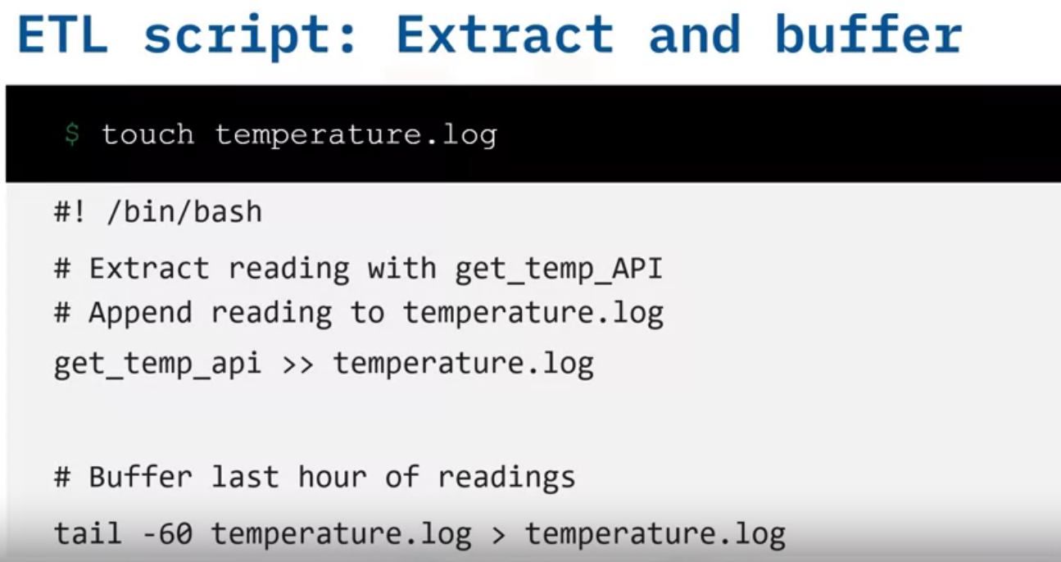
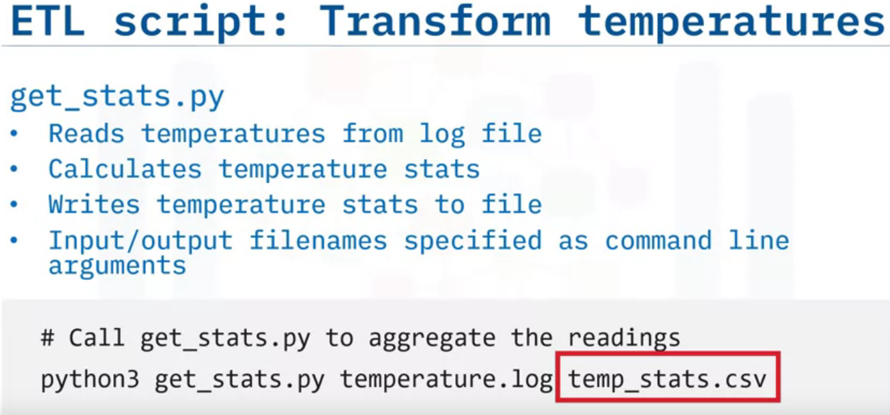
Now you can fill in some details for your task comments.
Start by initializing your temperature log file on the command line with the touch command.
In the text editor, enter a command to call the API to read a temperature, and append the reading to the temperature log.
Now, just keep the last hour, or 60 lines, of your log file, by overwriting the temperature log with its last 60 lines.
This completes the data extraction step.
suppose you have written a Python script, called ‘get_stats.py,’ which reads temperatures from a log file, calculates the temperature stats, and writes the result to an output file, so that the input and output filenames are specified as command line arguments.
You can add the following line to your ETL script, which calls ‘python3’ and invokes your Python script ‘get_stats.py,’ using the readings in ‘temperature.log,’ and writes the temperature stats to a CSV file called ‘temp_stats.csv.’
This completes the transformation component of your ETL script.
The common feature of popular ETL tools that helps with complex calculations is "Transformation support."

Slide 13
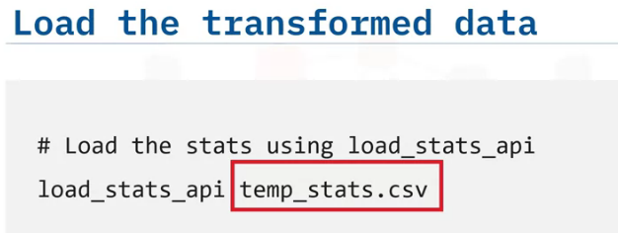
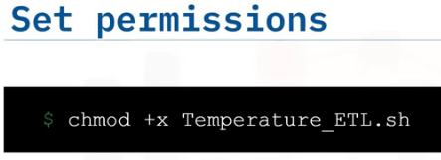
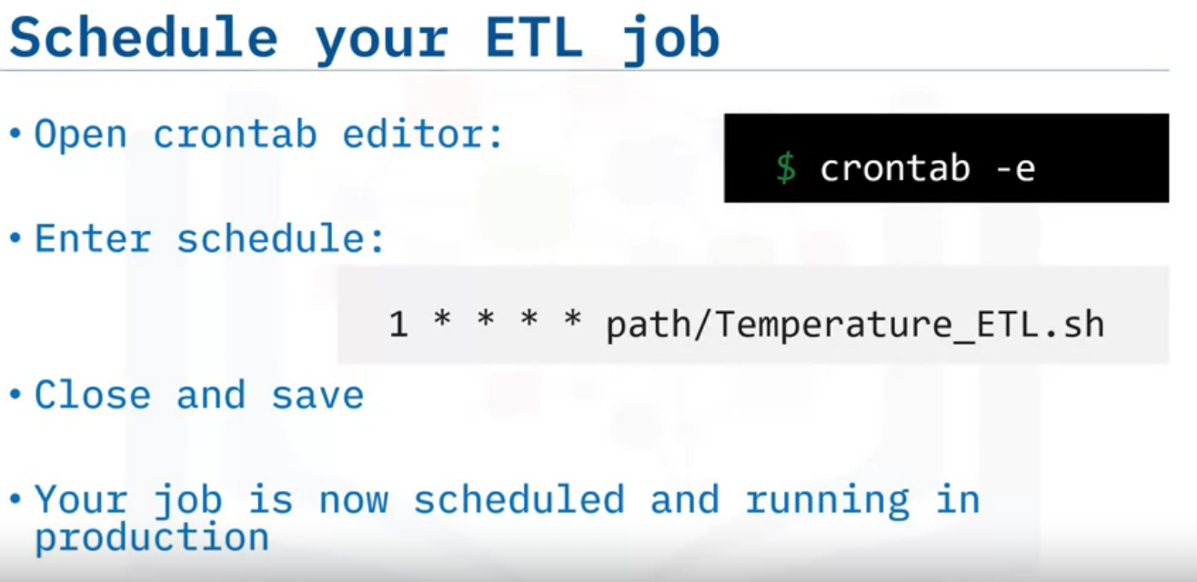
Finally, you can load the resulting stats into the reporting system using the supplied API, by calling the API and specifying the temperature stats CSV as a command line argument.
Next, don't forget to set permissions to make your shell script executable.
Now it’s time to schedule your ETL job.
Open the crontab editor.
Schedule your job to run every minute of every day.
Close the editor and save your edits.
Your new ETL job is now scheduled and running in production.

Slide 14
Part : 2: An Introduction to Data Pipelines
Define what a data pipeline is.
Describe data pipeline performance in terms of latency and throughput.
Give examples of data pipeline use cases.

Slide 15
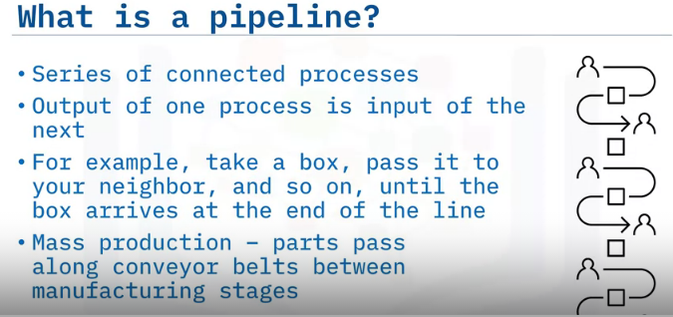
The concept of a pipeline applies broadly to any set of processes that are connected to each other sequentially.
This means that the output of one process is passed along as input to the next process in a chain.
For example, one way to move boxes from one place to another is to have a chain of friends, each passing the boxes one-by-one up the line to their nearest friend.
Each friend is a processor, whose function is identical: get a box, pass a box.
Mass production is similar, but transformations may differ from stage to stage.
What is a Data Pipeline?
Data pipelines are pipelines that specifically move or modify data.
The purpose of a data pipeline is to move data from one place or form to another.
A data pipeline is a system which extracts data and passes it along to optional transformation stages for final loading.
This includes low-level hardware architectures, but our focus here is on data pipelines as architectures driven by software processes, such as commands, programs, and processing threads.
The simple Bash pipe command in Linux can be used as the 'glue' that connects such processes together.

Slide 16
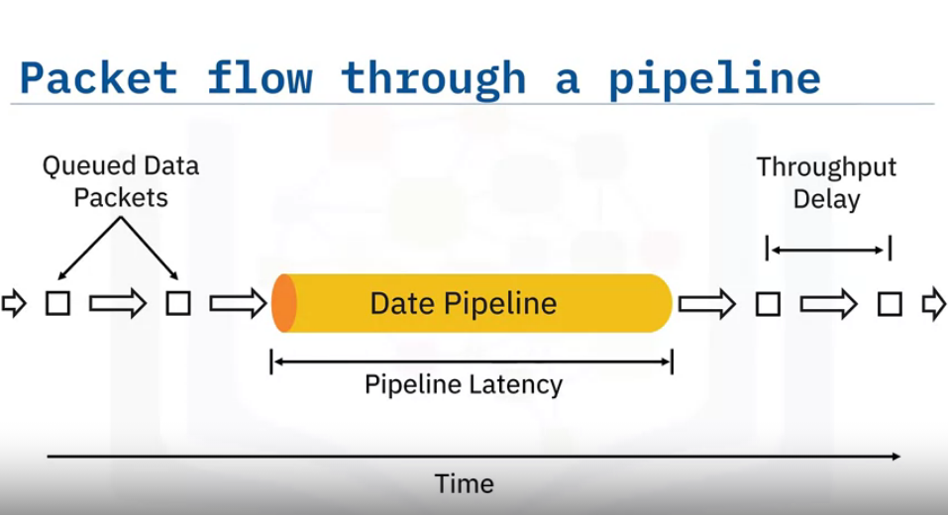
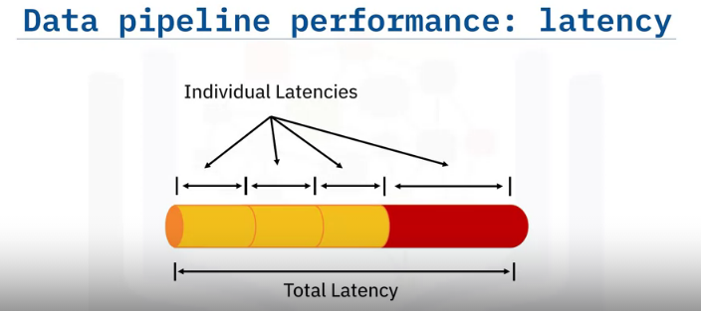
We can think of data flowing through a pipeline in the form of data packets, a term which we will use to broadly refer to units of data.
Packets can range in size from a single record, or event, to large collections of data.
Here, we have data packets queued for ingestion to the pipeline.
The length of the data pipeline represents the time it takes for a single packet to traverse the pipeline.[Latency]
The arrows between packets represent the throughput delays, or the times between successive packet arrivals.
You have just been introduced to two key performance considerations regarding data pipelines.
The first is latency, which is the total time it takes for a single packet of data to pass through the pipeline.
Equivalently, latency is the sum of the individual times spent during each processing stage within the pipeline.
Thus overall latency is limited by the slowest process in the pipeline.
For example, no matter how fast your internet service is, the time it takes to load a web page will be decided by the server's speed.

Slide 17
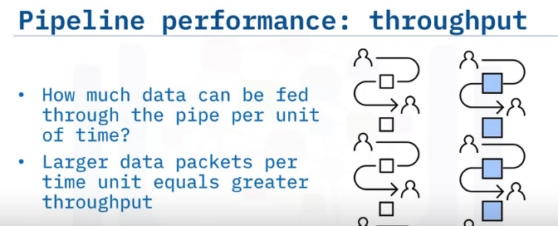
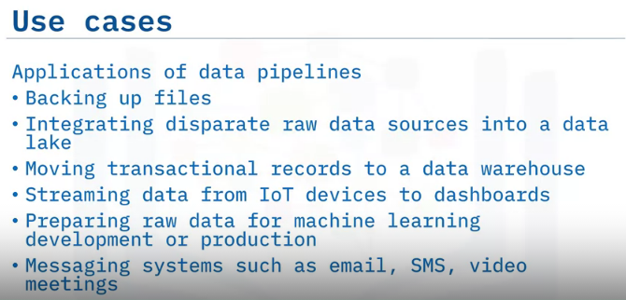
The second performance consideration is called throughput.
It refers to how much data can be fed through the pipeline per unit of time.
Processing larger packets per unit of time increases throughput.
Coming back to our example of having a chain of friends passing boxes from one to another, we can see in the right image, within limits, that passing bigger boxes can increase productivity.

Slide 18
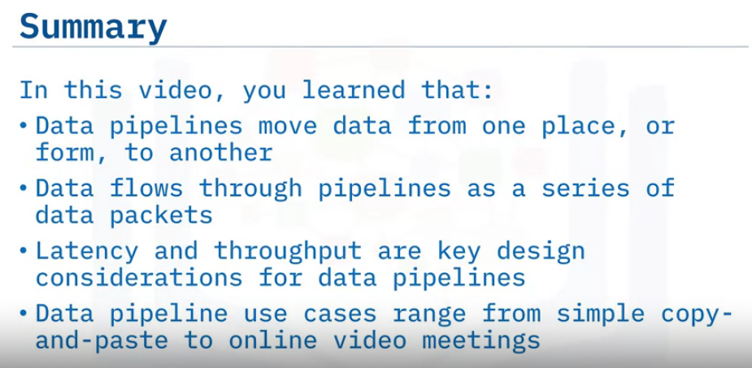

Slide 19
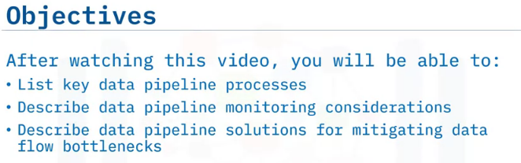
Key Data Pipeline Processes

Slide 20
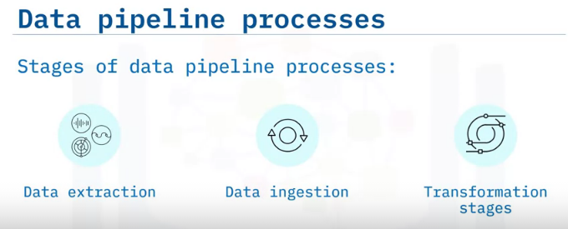
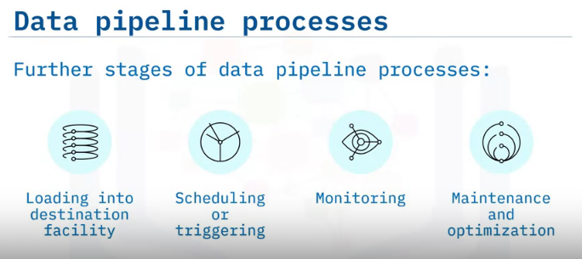
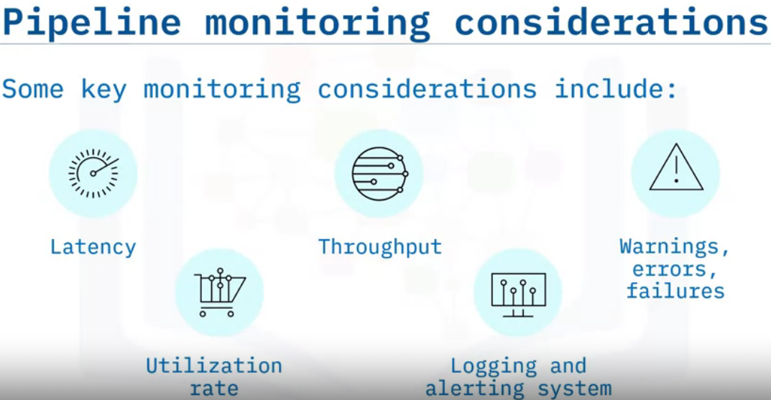
The data pipeline needs to be monitored once it is in production to ensure data integrity.
Some key monitoring considerations include: Latency, or the time it takes for data packets to flow through the pipeline.
Throughput demand, the volume of data passing through the pipeline over time.
Errors and failures, caused by factors such as network overloading, and failures at the source or destination systems.
Utilization rate, or how fully the pipeline's resources are being utilized, which affects cost.
Lastly, the pipeline should also have a system for logging events and alerting administrators when failures occur.

Slide 21
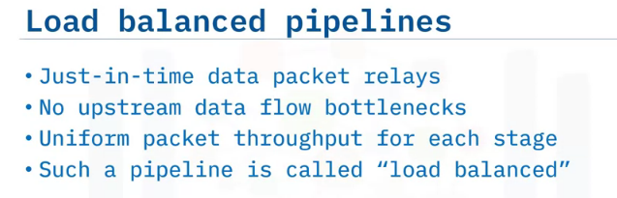
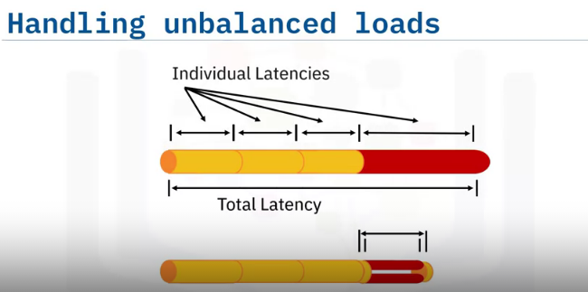
Ideally, at the moment, one stage has completed its process on a packet of data, the next packet in the queue would be available to it, just in time.
In that case, the stage is never left to idle while the pipeline is operating, and there are no upstream bottlenecks.
Extending this notion to all stages of the pipeline implies that all stages should take the same amount of time to process a packet.
This means there are no bottlenecks, and we can say that the entire pipeline has been load-balanced
Let's take a closer look at this idea.
Suppose your pipeline has a bottleneck in one of its stages, such as the longer red section here, which has more latency than the other stages in the pipeline.
If it's possible to parallelize that stage, for example by splitting the data into two concurrent stages, like this, then you can reduce this stage's latency.
There will be a little overhead in managing the parallelization and recombination of the output back into the pipeline, but the overall latency will be reduced.

Slide 22
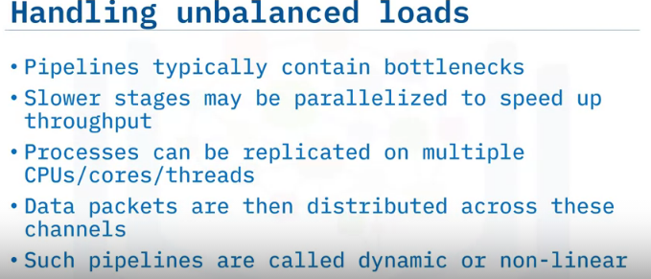
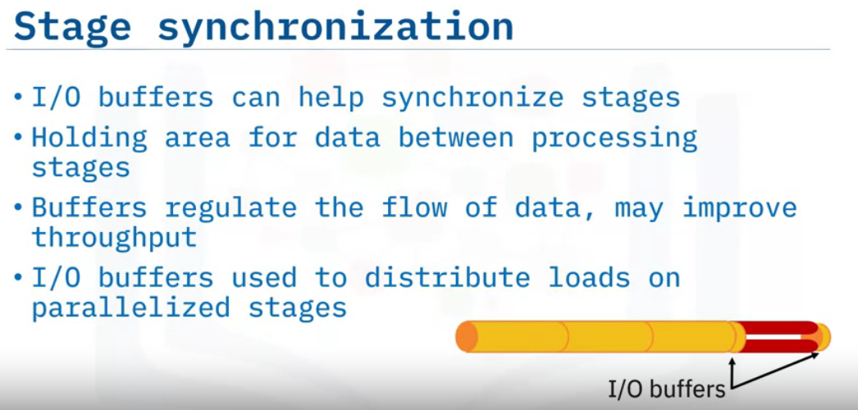
Due to time and cost considerations, pipelines are rarely perfectly load balanced.
This means there will almost always be stages which are bottlenecks in the data flow.
If such a stage can be parallelized, then it can be sped up to align better with the flow rate.
A simple way to parallelize a process is to replicate it on multiple CPUs, cores, or threads, and distribute data packets as they arrive, in an alternating fashion amongst the replicated channels.
Pipelines that incorporate parallelism are referred to as being dynamic or non-linear, as opposed to “static,” which applies to serial pipelines.
Further synchronization between stages is likely still possible, and a typical solution is to include input and output, or I/O buffers as needed to smooth out the flow of data.
An I/O buffer is a holding area for data, placed between processing stages having different or varying delays.
Buffers can also be used to regulate the output of stages having variable processing rates, and thus may be used to improve throughput.
Single input and output buffers are also used to distribute and gather loads on parallelized stages.

Slide 23
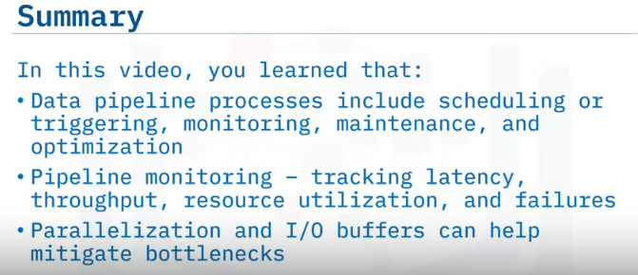

Slide 24
Batch Vs. Steaming Data Pipelines
Differentiate between batch and streaming data pipelines.
Describe micro-batch and hybrid Lambda data pipelines.
List use cases for batch data pipelines.
List use cases for streaming data pipelines.

Slide 25
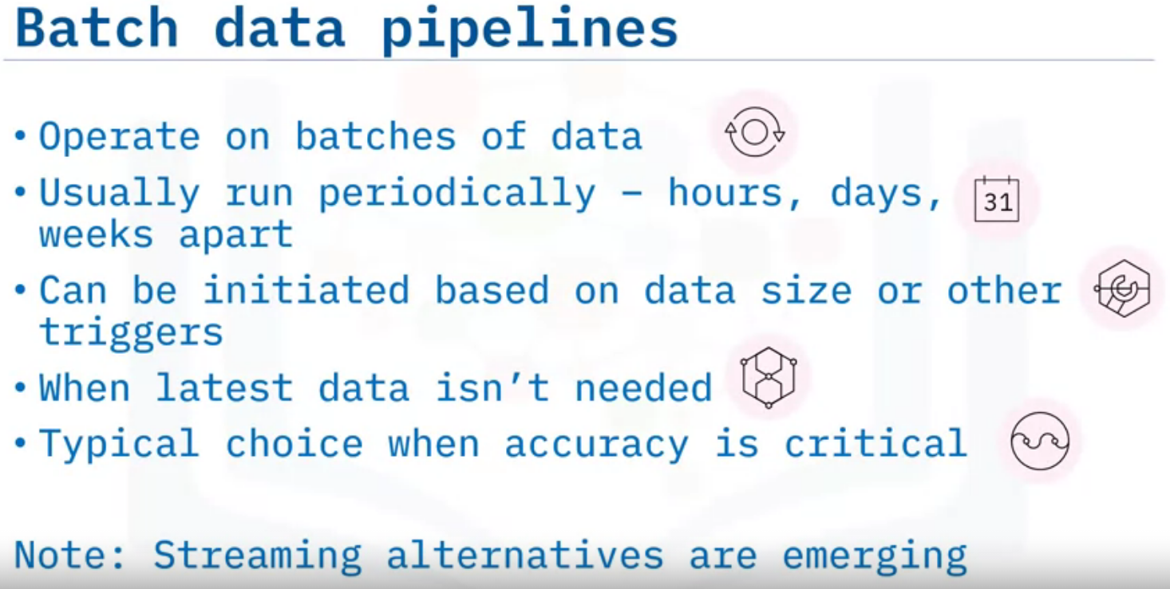
Batch data pipelines are used when datasets need to be extracted and operated on as one big unit.
Batch processes typically operate periodically on a fixed schedule – ranging from hours to weeks apart.
They can also be initiated based on triggers, such as when the data accumulating at the source reaches a certain size.
Batch processes are appropriate for cases which don't depend on recency of data.
Typically, batch data pipelines are employed when accuracy is critical, but competitive mission-critical streaming technologies are rapidly maturing.

Slide 26
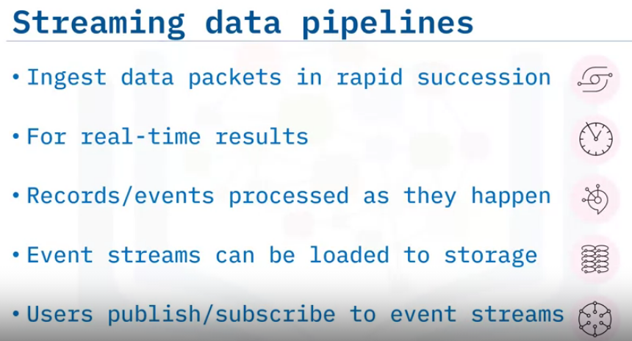
Streaming data pipelines are designed to ingest packets of information, such as individual credit card transactions or social media activities, one-by-one in rapid succession.
Stream processing is used when results are required with minimal latency, essentially in real-time.
With streaming pipelines, records or events are processed immediately as they occur.
Event streams can also be appended to storage to build up a history for later use.
Users, including other software systems, can publish (or write), and subscribe to (or read), event streams

Slide 27
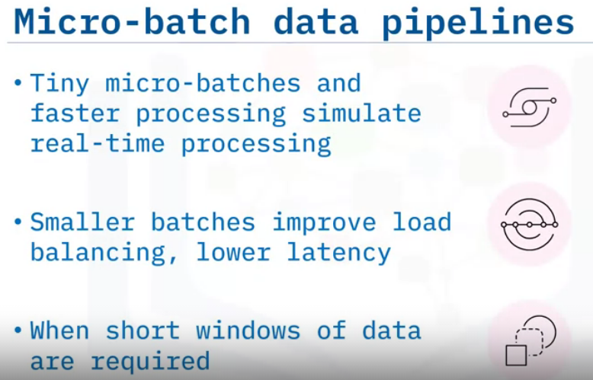
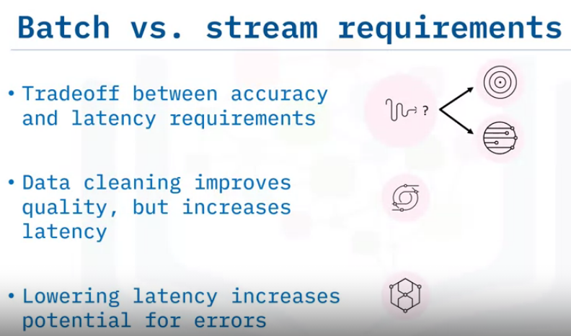
By decreasing the batch size and increasing the refresh rate of individual batch processes, you can achieve near-real-time processing.
Using micro-batches may also help with load balancing, leading to lower overall latency.
Useful when only very short windows of data are required for transformations.
The use case differences between batch and stream processing come down to a trade-off between accuracy and latency requirements.
With batch processing, for example, data can be cleaned. And thus you can get higher quality output, but this comes at the cost of increased latency.
If you require low latency, your tolerance for faults likely has to increase.

Slide 28
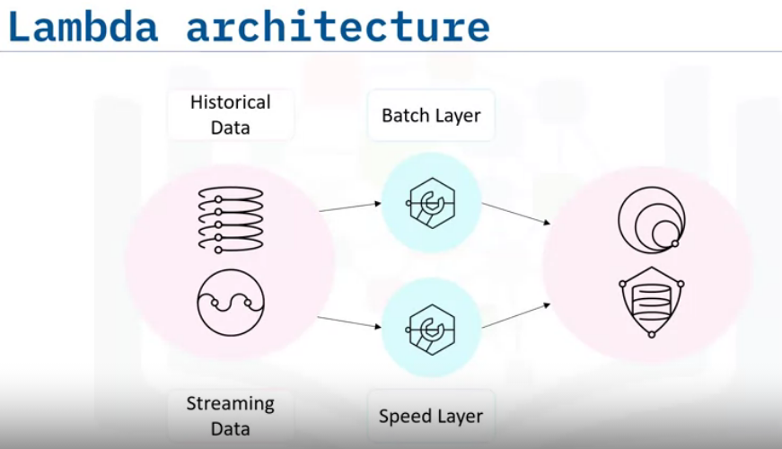
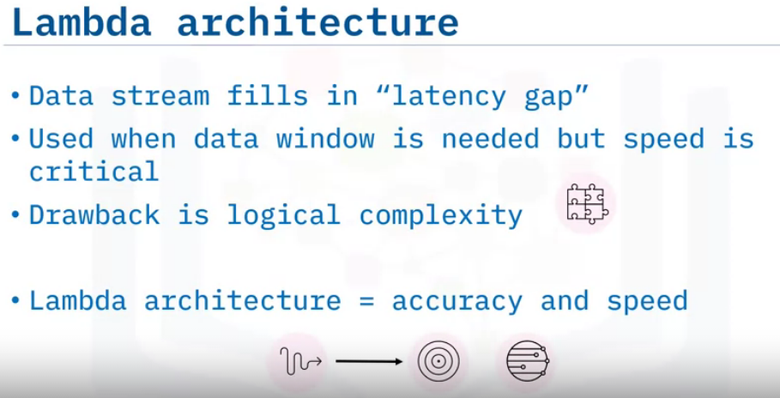
A Lambda architecture is a hybrid architecture, designed for handling Big Data.
Lambda architectures combine batch and streaming data pipeline methods.
Historical data is delivered in batches to the batch layer, and real-time data is streamed to a speed layer.
These two layers are then integrated in the serving layer.
The data stream is used to fill in the “latency gap” caused by the processing in the batch layer.
Lambda can be used in cases where access to earlier data is required but speed is also important.
A downside to this approach is the complexity involved in the design.
You usually choose a Lambda architecture when you are aiming for accuracy and speed.

Slide 29
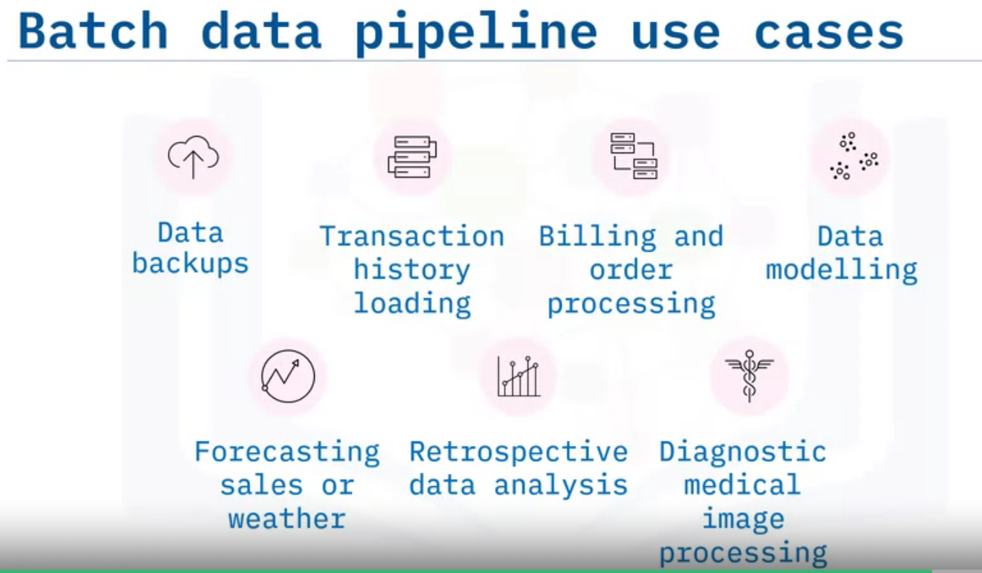
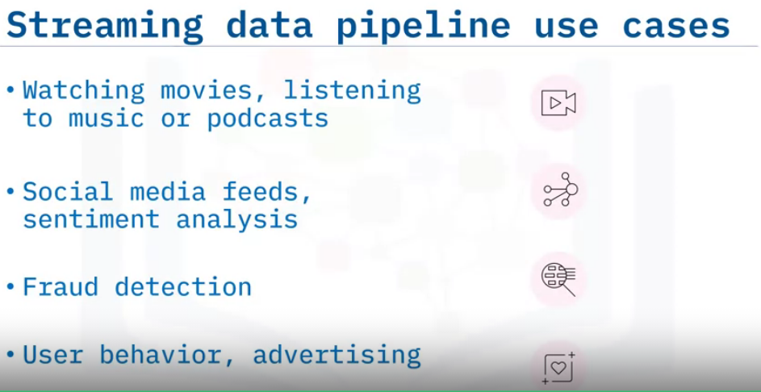
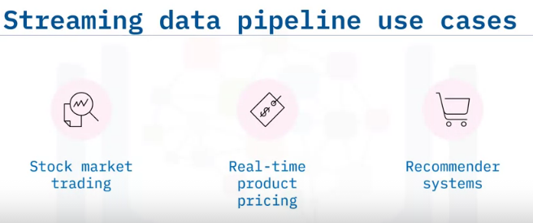
You usually choose a Lambda architecture when you are aiming for accuracy and speed.
Example use cases for batch data pipelines include:
Periodic data backups.
And transaction history loading.
Processing of customer orders and billing.
Data modelling on slowly varying data.
Mid- to long-range sales forecasting and weather forecasting.
Analysis of historical data.
Diagnostic medical image processing.
Use cases for streaming data pipelines are on the rise, and include cases such as

Slide 30
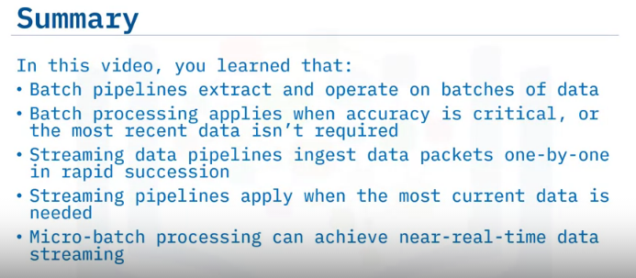

Slide 31
Data Pipeline Tools & Technologies
Discuss data pipeline technologies.
List open source and enterprise ETL and ELT tools, and
List streaming data pipeline tools.

Slide 32
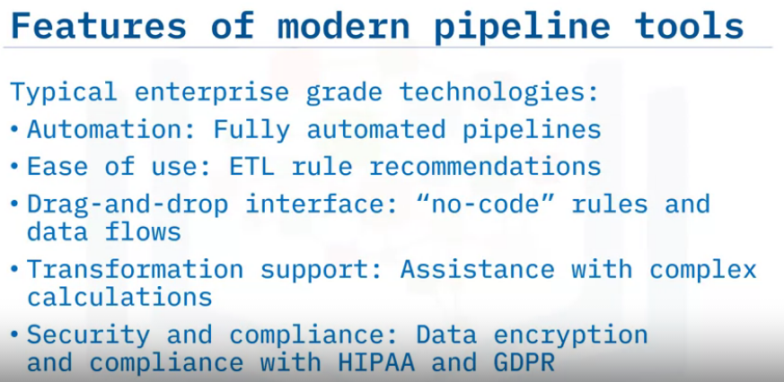
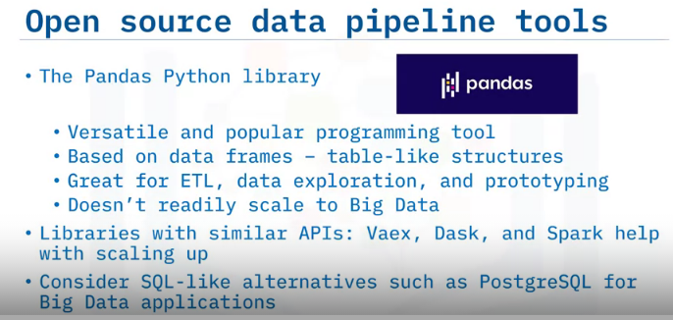

Slide 33
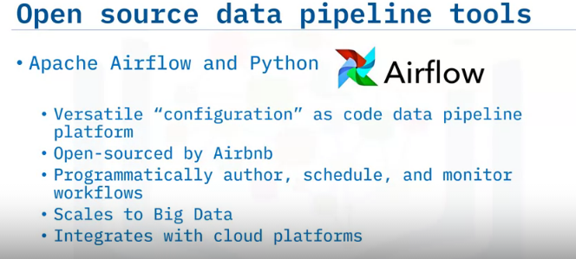
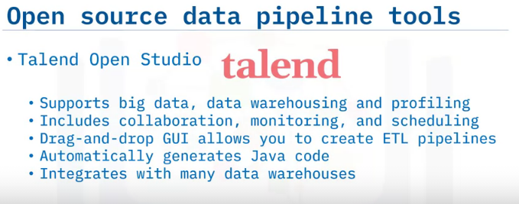
Apache Airflow, another package based on the Python programming language, is a highly versatile and well-known example of an open-source “configuration as code” data pipeline platform.
Apache Airflow was open-sourced by Airbnb, and was created to programmatically author, schedule, and monitor data pipeline workflows.
It was designed to be scalable, and can handle an arbitrary number of parallel compute nodes, and Airflow integrates with most cloud platforms, including AWS, IBM, Google Cloud, and Microsoft Azure.
Talend Open Studio is yet another open source data pipeline development and deployment platform.
Talend Open Studio supports big data migration, data warehousing, and profiling, and it includes collaboration, monitoring, and scheduling capabilities.
It also has an interactive drag and drop GUI, which allows you to create ETL pipelines.
There is no need to write code, as Java code is automatically generated.
It also connects to many data warehouses, such as Google sheets, RDBMS, IBM db2, and Oracle.

Slide 34
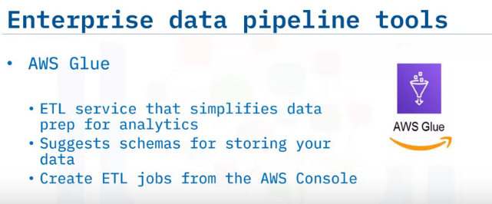
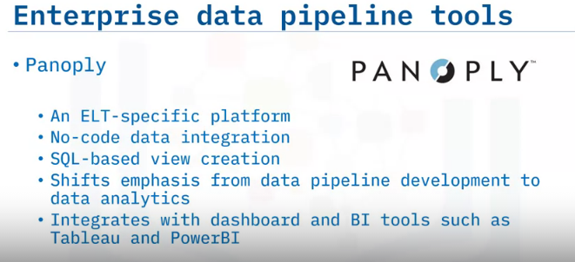
Amongst the many enterprise data pipeline tools, AWS Glue is a fully managed ETL service that makes it easy for you to prepare and load your data for analytics.
Glue crawls your data sources to discover data formats, and suggests schemas to store your data, and you can quickly create and run an ETL job using the AWS Console.
Panoply is another enterprise solution, but its focus is on ELT rather than ETL.
It handles data connection and integration without code, and comes with SQL functionality so you can generate views of your data.
This frees your time to focus on data analysis rather than optimizing your data pipeline.
Panoply also integrates with many dashboard and BI tools, including Tableau and PowerBI.

Slide 35
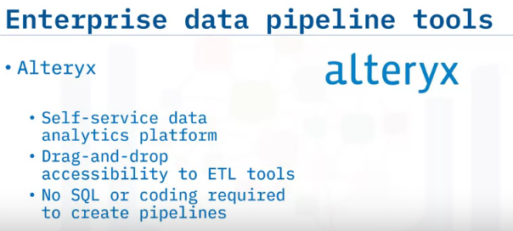
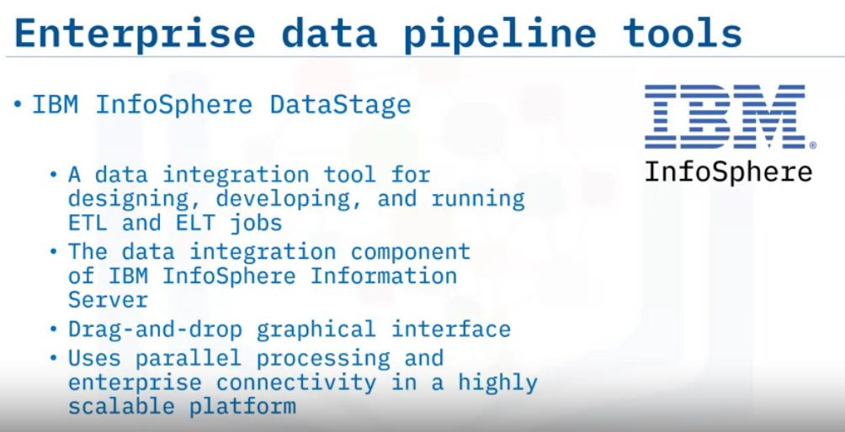
Alteryx is another well-known commercial data pipeline tool.
Alteryx is also a highly versatile, self-service data analytics platform with multiple products.
It gives you drag-and-drop accessibility to built-in ETL tools.
And, you don't need to know SQL or programming to create and maintain a complex data pipeline.
InfoSphere DataStage is the data integration component of IBM InfoSphere Information Server.
Like many other platforms, it also provides a drag-and-drop framework for developing workflows.
InfoSphere DataStage also uses parallel processing and enterprise connectivity to provide a truly scalable platform.

Slide 36
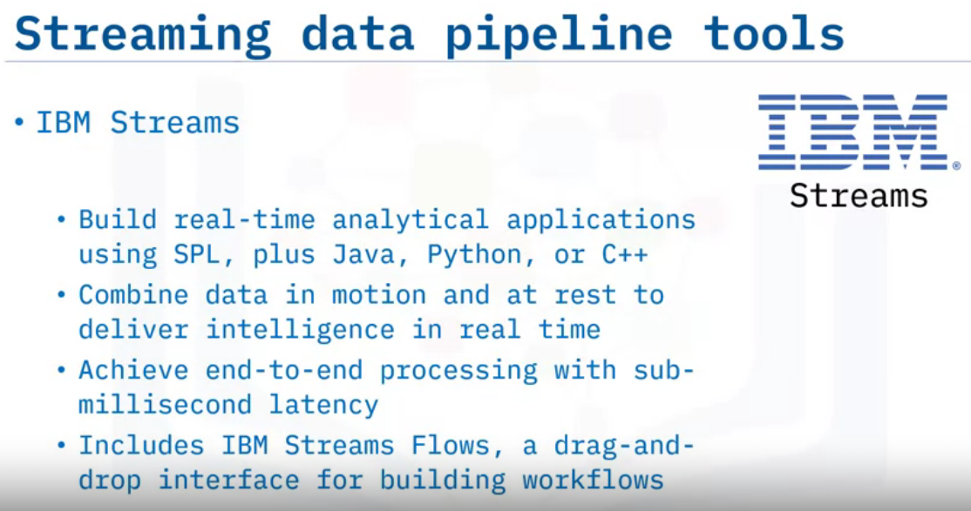
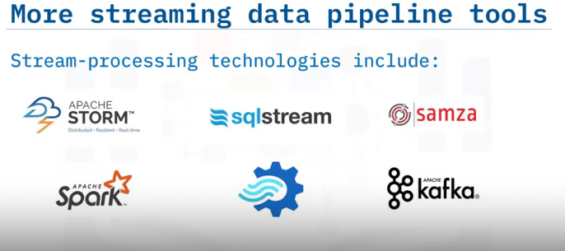
IBM Streams is a streaming data pipeline technology, which enables you to build real-time analytical applications using the Streams Processing Language, or SPL, plus Java, Python, or C plus plus.
You can use it to blend data in motion with data at rest to deliver continuous intelligence in real time.
Streams powers a Stream Analytics service that allows you to ingest and analyze millions of events per second with sub-millisecond latency, and
IBM Streams comes packaged with IBM Streams Flows, a tool which allows you to drag and drop operators onto a canvas, and modify parameters from built-in settings panels

Slide 37
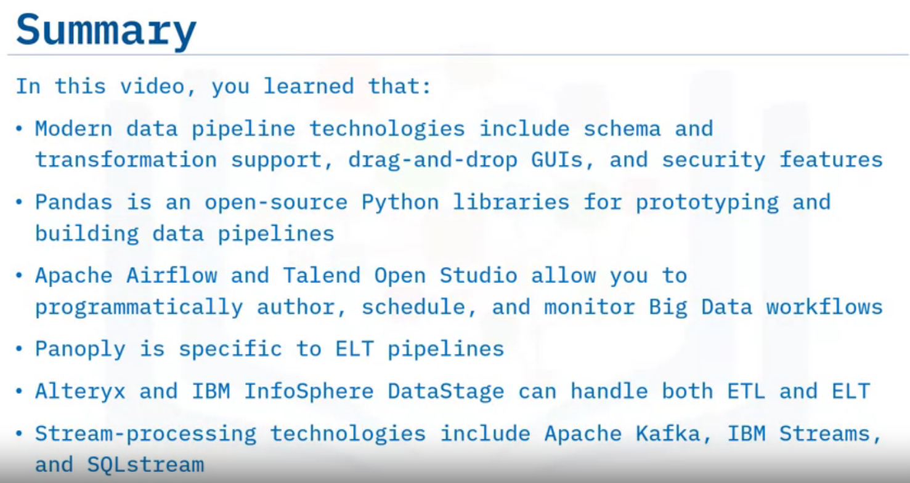

Slide 38
